Slide 1
Cosmos DB: No Mystery
Beth Wolfset, Senior Data Architect
Christy Marcelyn, Data Engineer
https://github.com/BSWolfset/PresentationSlidedecks
Email: Beth.Wolfset@insight.com
bswolfset@gmail.com
Christy.Marcelyn@insight.com
Marcelyn.Christy@gmail.com
Notes:
RI MS Business Intelligence User Group – May 23, 2018 – No SQL, No Mystery
Boston Code Camp – April 7, 2018 – No SQL, No Mystery
Granite State Code Camp – Nov 2, 2019 – No SQL, No Mystery
Fall 2019 – Boston Azure Data Fest – Dec 10, 2019 – Cosmos DB: No Mystery

Slide 2
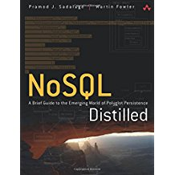
Resources
https://www.cl.cam.ac.uk/~fms27/db/tr-98-2.pdf
https://www.3pillarglobal.com/insights/exploring-the-different-types-of-nosql-databases
https://searchdatamanagement.techtarget.com/definition/NoSQL-Not-Only-SQL
https://medium.com/@pepekamel/sql-vs-nosql-optimal-uses-b722475ec704
http://scraping.pro/where-nosql-practically-used/
https://www.slideshare.net/Dataversity/nosql-now-nosql-architecture-patterns-23589170
https://www.dezyre.com/article/nosql-vs-sql-4-reasons-why-nosql-is-better-for-big-data-applications/86
https://cosmosdb.github.io/labs/
https://github.com/AzureCosmosDB/scenario-based-labs/
https://github.com/BSWolfset/PresentationSlidedecks
Notes:
https://www.cl.cam.ac.uk/~fms27/db/tr-98-2.pdf
https://www.3pillarglobal.com/insights/exploring-the-different-types-of-nosql-databases
https://searchdatamanagement.techtarget.com/definition/NoSQL-Not-Only-SQL
https://medium.com/@pepekamel/sql-vs-nosql-optimal-uses-b722475ec704
http://scraping.pro/where-nosql-practically-used/
https://www.slideshare.net/Dataversity/nosql-now-nosql-architecture-patterns-23589170
https://www.dezyre.com/article/nosql-vs-sql-4-reasons-why-nosql-is-better-for-big-data-applications/86
https://cosmosdb.github.io/labs/
https://github.com/AzureCosmosDB/scenario-based-labs/

Slide 3
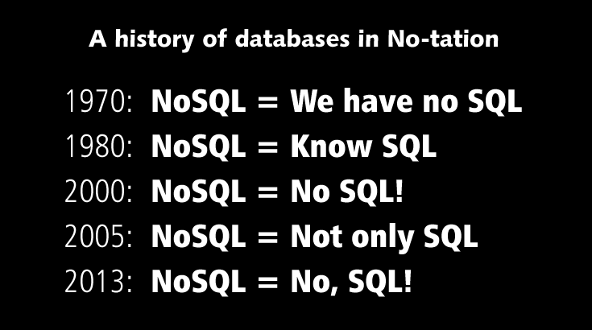
A history of databases in No-tation
http://www.vertabelo.com/blog/notes-from-the-lab/why-sql-is-neither-legacy-nor-low-level-but-simply-awesome
Notes:
http://www.vertabelo.com/blog/notes-from-the-lab/why-sql-is-neither-legacy-nor-low-level-but-simply-awesome

Slide 4





Azure Cosmos DB
Core (SQL) API
Table API
MongoDB
Column-family
Document
Key-value
Graph
Guaranteed low latency at the 99th percentile
Elastic scale out
of storage & throughput
Five well-defined consistency models
Turnkey global distribution
Comprehensive SLAs

Slide 5
Types of Databases
Types considered NO SQL
Products offered by Microsoft
Products part of Cosmos DB
Database Type | Example |  |  | Database Type | Example
Relational (SQL) | SQL Server SQL Database Oracle Sybase | MySQL MS Access |  | Document | Lotus Notes CouchBase CouchDB MongoDB | OrientDB Raven Terrastore Azure DocumentDB MongoDB API
Graph & Resource Description Framework (RDF) | Neo4J Flock HyperGraph Infinite Graph | Jena Sesame AllegoGraph MS Graph Gremlin API |  | Search Engine | ElasticSearch Splunk Solr | MarkLogic Sphinx
Key-Value | Berkely Level Memcached | Riak Redis Azure Tables Table API |  | Column-Family | Cassandra HBase Hypertable | Amazon Simple DB Cassandra API
Object-Oriented | Cache ObjectStore Objectivity/DB | Db4o Versant |  | Hierarchical

Slide 6
Relational Database
Description:
Based on relational algebra
Data represented as tables and columns
CosmosDB API: None
Pros:
Good for structured data
Wide variety of mature tools
Cons:
May not scale well
tblUser
tblUser
tblOffice

Slide 7
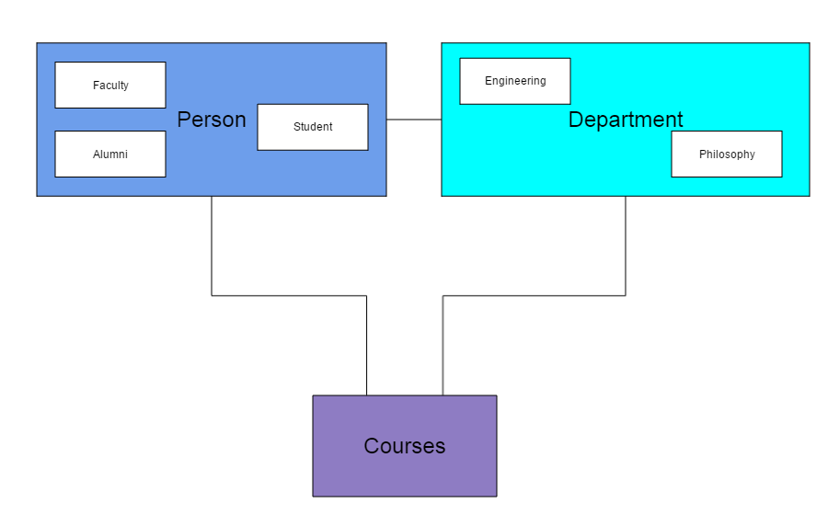
Object-Oriented Database
Description:
user-defined data types
nested objects, sets, lists
methods & rules
preserve strong typing

Slide 8

Code First vs Model First
Code First
Build code-data structures in memory
Measured on speed to provide functionality
OR/M maps structures to DB
Limits need to understand DB Access
Goals
Ease of Development
Understand code
Model First
Understand data and future growth
Use standards and templates
Measured on multiple uses across applications
Consistency of model facilitates efforts
Goals
Efficient Storage
Performant Retrieval
Understand DB
Data Abstraction Layer
Microservices
Stored Procedures
Notes:
Mapping issue between in-memory structures and persistence layer
This started as an Object-Relational Mapper (OR/M) debate. But, it pertains to any system that is helping to simplify the database access.
ORM Hate
Both approaches could require data model to be refactored as application is built out
In Code First, this is because all needs for data were not anticipated.
In Model First, for performance reasons, some aspects of model may need to be denormalized
If using an OR/M, need to understand how these model/map changes can be made
Discussion of Code First vs Database First vs Model First. While we can talk about this under the Entity Framework umbrella, this issue is the heavyweight fight of O/RM vs Database. There is no right answer and mistakes can be made regardless of which approach you use.
Developers prefer Code first:
They think code
Measured on how to quickly provide the needed functionality
Build code creating database tables as needed
May require data model to be re-factored as application is built out
Data modelers prefer Model first:
There are standards and templates for common objects
Measured on how a data model stands up to a variety of uses, not just one application
Implement consistency across data model, enhances understanding and minimizes efforts downstream
Employ methods to allow model to accept changes in the database without needing major refactor of data model
DBAs may be split
Database first only works for existing DBs
For new DBs, DBAs will take direction from whoever’s approach means the least amount of changes to the DB
What is really needed:
Data Abstraction Layer https://msdn.microsoft.com/en-us/library/ff650706.aspx
An abstraction of the data model
An API between the Application or Service layer and the DB
Allows application to not be affected by DB changes
Allows O/RM to be closely aligned with Data Abstraction Layer (DAL)
Don’t confuse with Data Access Layer
What can be used to build the Data Abstraction Layer
Services (web or microservices) – if services are used these should include no business logic and should not morph into business services
Stored Procedures – again, these should not include the business logic. These should be limited to what the DB does best: read, insert and update of data. Complex logic belongs in a programming language.
Views
The method should be chosen by the architecture team and adhered to across the project.

Slide 9
Impedance Match
{
"course": {
"courseId": "ENG 301",
"instructor": {
"name": {
"first_name": "Severus",
"last_name": "Snape"
},
"ssn": "999-999-9999"
},
"students": [
{
"name": {
"first_name": "Harry",
"last_name": "Potter"
},
"ssn": "111-111-1111"
},
{
"name": {
"first_name": "Luna",
"last_name": "Lovegood"
},
"ssn": "222-222-2222"
}
]
}
}
{
"person": {
"name": {
"first_name": "Severus",
"last_name": "Snape"
},
"ssn": "999-999-9999",
"active_status": true,
"person_type": "External",
"role": {
"faculty": {
"department": "Engineering",
"salary": "80000"
},
"student": {
"fee": 0
}
},
"course": {
"courseId": "ENG 301"
}
}
}
Match between application structures and data structures in DBMS
App wants to access data in specific ways
Alternative storage approaches attempt to close gap between application and DBMS

Slide 10
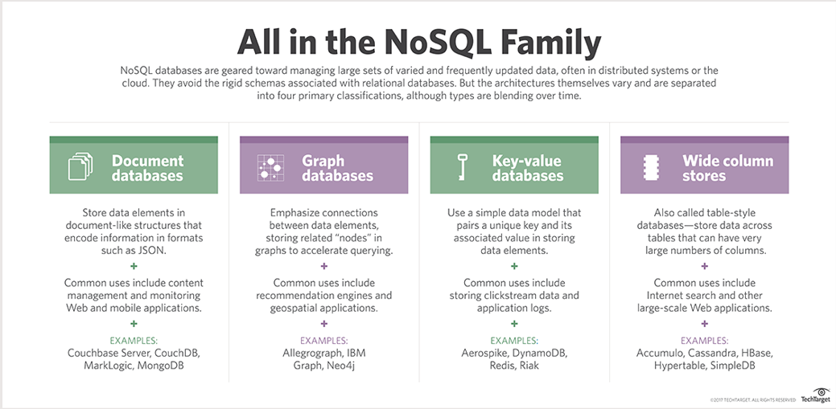
The NoSQL Family
https://searchdatamanagement.techtarget.com/definition/NoSQL-Not-Only-SQL
Notes:
https://searchdatamanagement.techtarget.com/definition/NoSQL-Not-Only-SQL

Slide 11
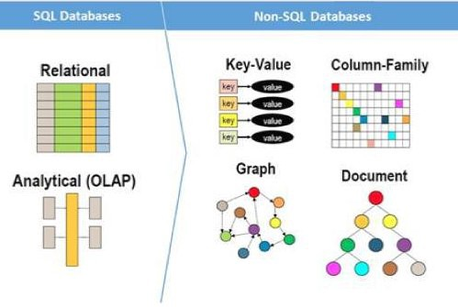
Images
Table API
Cassandra API
SQL API
MongoDB API
Gremlin API
https://medium.com/@pepekamel/sql-vs-nosql-optimal-uses-b722475ec704

Slide 12
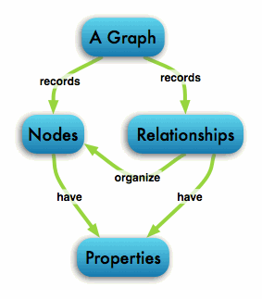
Graph Database
Description:
Emphasize node/vertex and edges
Both can have properties
Use Case:
Social networking
Access control
Geospatial applications
Recommendation engines
Jim
Beth
CosmosDB API: Gremlin
Pros:
Allows tracking of relationships
Flexible, Fast
Cons:
Not good a storing a lot of data
Mary
Adam
Notes:
http://neo4j-org-dev.herokuapp.com/learn/graphdatabase

Slide 13
Key-Value Database
Description:
Key-Value pairs stored in hash table by key
Use Case:
Clickstream data
Application Logs
Session Information
Key: Name1
Value: Beth
CosmosDB API: Table, ETCD
Key: Name2
Value: Jim
Pros:
Easy to get started
Excellent performance
Key: Name3
Value: Adam
Key: Repo1
Value: BSWolfset
Cons:
May be difficult to keep logical keys unique
Key: Blog2
Value: GraniteStateHacker
Notes:
http://scraping.pro/where-nosql-practically-used/

Slide 14
Document Store Database
Description:
Similar to key-value store where value has structure (document)
Document frequently stored as JSON Structure
Use Case:
Content management
CosmosDB API: MongoDB
Document 1
Name: Beth
Age: 44
Repo: BSWolfset
Document 2
Name: Jim
Age: 39
Blog: GraniteStateHacker
Document 3
Name: Adam
Age: 26
Pros:
Easy to add new fields to document
Blog: GrantiteStateHacker
URL: https://granitestateusersgroupsorg.wordpress.com/
Cons:
Difficult to maintain data integrity
Repo: BSWolfset
URL: https://github.com/BSWolfset/PresentationSlidecks
File: CosmosDB_NoMystery_201912.pptx
Notes:
http://scraping.pro/where-nosql-practically-used/

Slide 15
Column Store Database
Description:
Data stored in columns and cells rather than tables and rows
Use Case:
Searching applications
CosmosDB API: Cassandra
ID = 1
Name:
Beth
Age:
44
Repo:
BSWolfset
Pros:
Fast search on columns of data
ID = 2
Name:
Jim
Age:
39
Blog:
GraniteStateHacker
Cons:
Single record is distributed and harder to build
ID = 3
Name:
Adam
Age:
26
Notes:
http://scraping.pro/where-nosql-practically-used/

Slide 16
Big Data and NO SQL
Volume – significant amounts of data
Velocity – speed of arrival of data
Variety – different types of data
Veracity – is the data trustworthy
Value – will the insights provide business worth
NO SQL Databases Allow for
Scalability – vertical and horizontal
Flexibility and Performance
Notes:
https://www.dezyre.com/article/nosql-vs-sql-4-reasons-why-nosql-is-better-for-big-data-applications/86

Slide 17
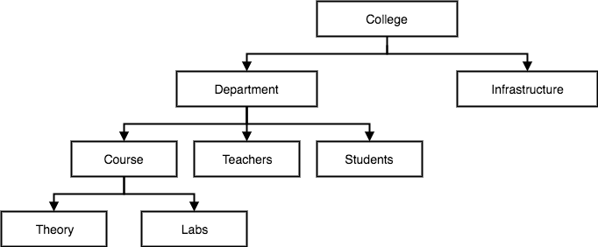
Hierarchical Database
Description:
Use hierarchical arrangement elements
Use Case:
Hierarchical data
Common DBs: Mumps
Pros:
Intuitive for storing hierarchical data
Cons:
Replication
Asymmetry
Notes:
https://www.studytonight.com/dbms/database-model.php

Slide 18
Data Architecture and Not Only SQL
NO SQL – Not Only SQL
Implies a non-relational database
Does not imply there is no structure to the data
Data may be stored in methods that do not require the structure to be understood a priori
Structure of data may be defined at query time
NO SQL does not mean NO Data Architect
The Data Architect understands what data is available and the methods of accessing it, regardless of the management system
Data requires documentation
Some No SQL models allow Schema-On-Read
NO
SQL
✓
Notes:
With storage becoming cheaper and new ways to analyze data, Companies are becoming Data Hoarders
https://www.datanami.com/2016/06/13/growing-menace-data-hoarding/
http://www.cioinsight.com/blogs/are-you-a-data-hoarder.html

Slide 19
Thank You
Beth Wolfset
Email: beth.wolfset@insight.com
bswolfset@gmail.com
Twitter: @beth_wolfset
Christy Marcelyn
Email: christy.marcelyn@insight.com
marcelyn.Christy@gmail.com
https://github.com/BSWolfset/PresentationSlidedecks

